Slide 1
Symbol Puzzle - skeleton code (Paper 1)
Intro theory + practice code tasks (4)

Slide 2

Symbol Puzzle - skeleton code (Paper 1) - Intro theory + practice code tasks (4)
TASK 1 - "Hi-score table"
Modify the AttemptPuzzle method in the Puzzle class to prompt the user (after each turn) if they would like to save the current score.
If the user confirms, the modification should ask the user to input their name
The user name and the current score should be saved to a text file.
As this is a "hi-score" table, any previous data should be preserved.

Slide 3
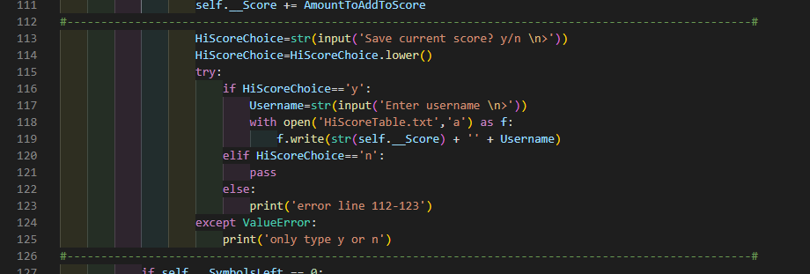
Symbol Puzzle - skeleton code (Paper 1) - Intro theory + practice code tasks (4)
TASK 1
<< YOUR ANSWER GOES HERE >>

Slide 4
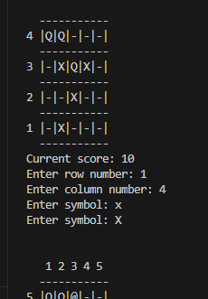
Symbol Puzzle - skeleton code (Paper 1) - Intro theory + practice code tasks (4)
TASK 2a
Currently if the user inputs a lower-case symbol -->
… no helpful error message is shown
Modify the GetSymbolFromUser method so that a suitable error message can be generated to inform the player

Slide 5
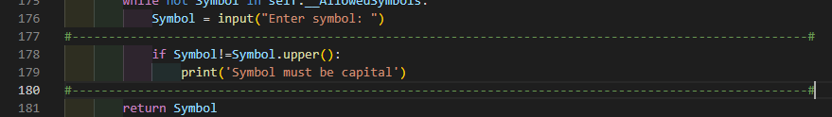
Symbol Puzzle - skeleton code (Paper 1) - Intro theory + practice code tasks (4)
TASK 2a
<< YOUR ANSWER GOES HERE >>

Slide 6
Symbol Puzzle - skeleton code (Paper 1) - Intro theory + practice code tasks (4)
TASK 2b
Currently if the user inputs a lower-case symbol -->
… no helpful error message is shown
Modify the GetSymbolFromUser method so that if a user inputs a lower-case symbol, it is converted by the program to upper-case

Slide 7
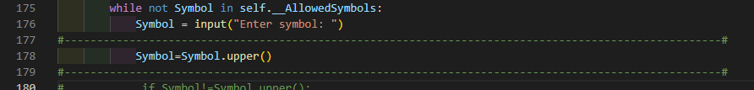
Symbol Puzzle - skeleton code (Paper 1) - Intro theory + practice code tasks (4)
TASK 2b
<< YOUR ANSWER GOES HERE >>

Slide 8
Symbol Puzzle - skeleton code (Paper 1) - Intro theory + practice code tasks (4)
TASK 3
Currently when the user inputs a symbol and row/column (cell) values the program does not detect if a symbol already exists in that cell
Modify the program to warn the user a symbol already exists in that cell
The modification should also inform the user what the current symbol in that cell is

Slide 9
Symbol Puzzle - skeleton code (Paper 1) - Intro theory + practice code tasks (4)
TASK 3
<< YOUR ANSWER GOES HERE >>

Slide 10
Symbol Puzzle - skeleton code (Paper 1) - Intro theory + practice code tasks (4)
TASK 4 - "Hi-score table - advanced"
Modify the AttemptPuzzle method in the Puzzle class to prompt the user (after each turn) if they would like to save the current board
If the user confirms, the modification should save the status of the game and board to a text file, following the same format and structure of the existing save-game files

Slide 11
Symbol Puzzle - skeleton code (Paper 1) - Intro theory + practice code tasks (4)
TASK 4
<< YOUR ANSWER GOES HERE >>

